Slide 1
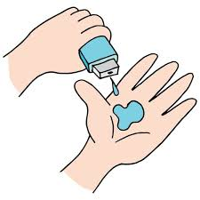
Project Title – Seasonal Agriculture Performance
Student Name : Kalva Subba Meghana
College Name : G. Narayanamma Institute of Technology and Science
AICTE STU ID :STU69f3b04b2c5671777578059

Slide 2

PROBLEM STATEMENT
Agricultural activities are influenced by seasonal variations in environmental conditions, farming practices, resource availability and market conditions. As a result, agricultural performance may differ from one season to another. However, raw agricultural data does not clearly explain how agricultural performance changes across seasons or what patterns can be observed in different seasonal conditions. The problem is to analyze the given agricultural dataset and investigate seasonal differences in agricultural performance by identifying meaningful patterns, trends, relationships and variations within the available data.

Slide 3
Project Description
Seasonal Agriculture Performance Analysis is a data analytics project that examines how agricultural performance varies across different seasons. The analysis uses information on crop production, environmental conditions, farming practices, resource usage, and economic outcomes to identify seasonal patterns, relationships, and variations.
The project compares yield, production, revenue, profit, water efficiency, environmental conditions, crops, regions, and resource usage across seasons. Statistical analysis and visualizations are used to identify significant observations and unusual patterns. The findings provide evidence-based insights and recommendations to support better seasonal agricultural planning and decision-making.

Slide 4

WHO ARE THE END USERS?
Farmers – to understand which seasons and farming practices give better yield and profitability.
Agricultural planners – to plan crops, resources, and activities according to seasonal performance.
Government agricultural departments – to support seasonal agricultural policies and resource allocation.
Agricultural analysts/researchers – to study seasonal, environmental, and regional agricultural patterns.
Agribusinesses – to make decisions related to production, resources, and market opportunities.

Slide 5

Technology Used
Python – Programming language for data analysis
Pandas – Data loading, cleaning, manipulation, and analysis
NumPy – Numerical calculations and statistical computations
Matplotlib – Data visualization and charts
Seaborn – Statistical visualizations such as heatmaps and boxplots
Google Colab / Jupyter Notebook – Development and execution environment

Slide 6
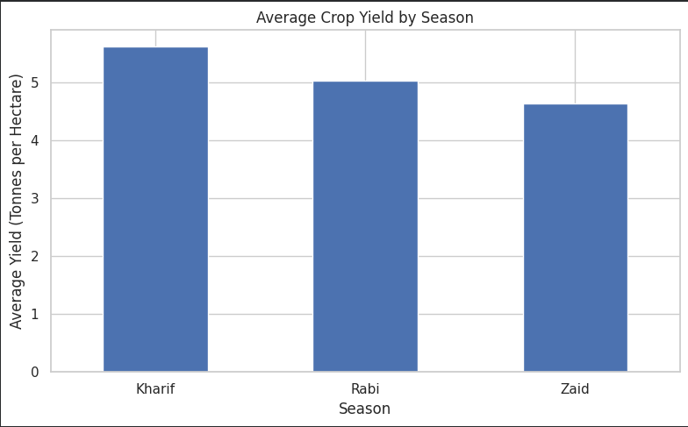
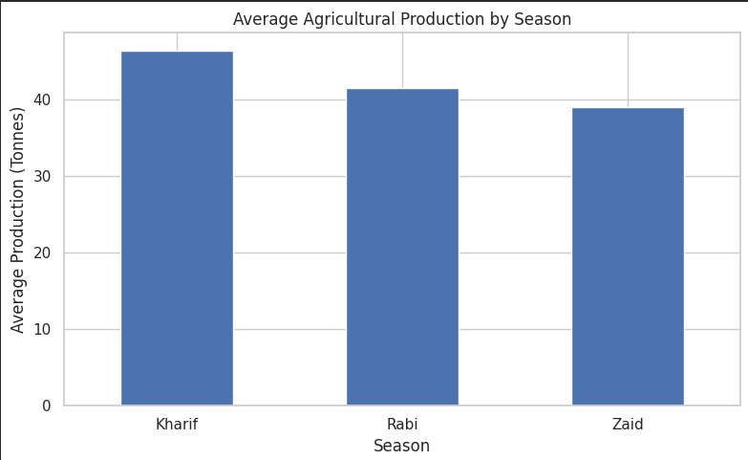
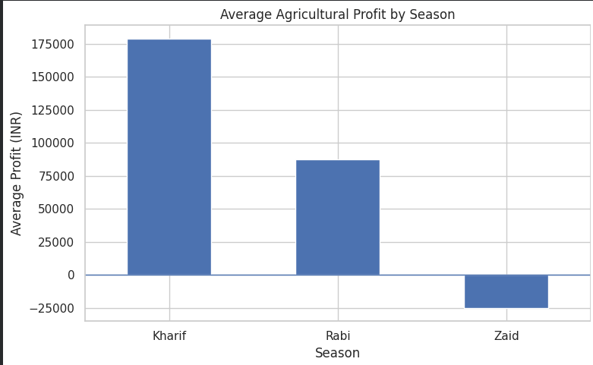
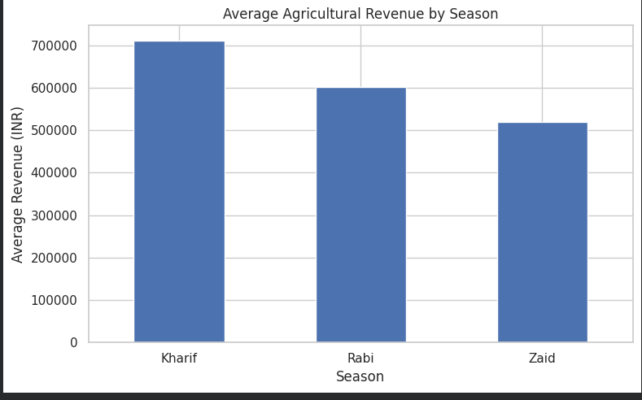
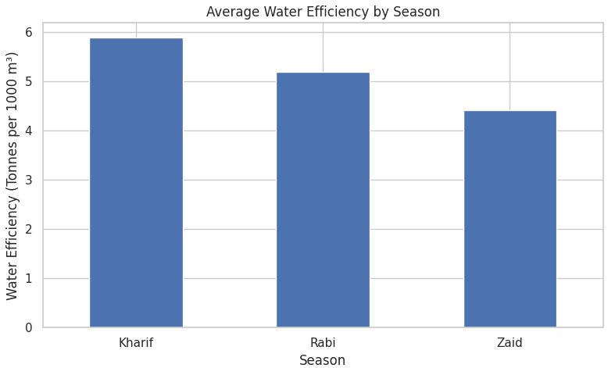
RESULTS
Kharif showed the strongest overall agricultural performance, while Zaid recorded the lowest performance and negative average profit.

Slide 7
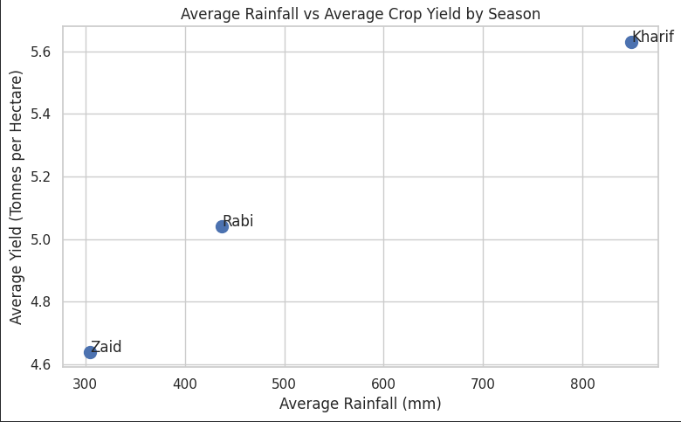
RESULTS
Kharif received the highest average rainfall and also recorded the highest average crop yield. Rabi showed moderate rainfall and yield, while Zaid had the lowest values.

Slide 8
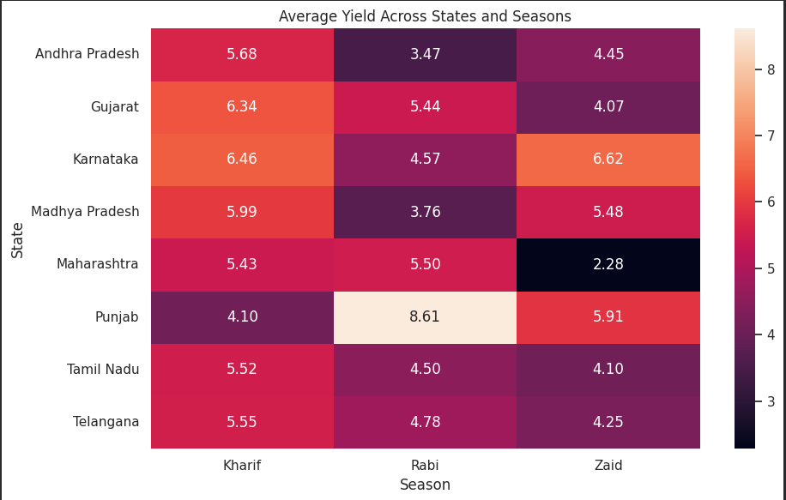
RESULTS
Yield varies across both states and seasons. Kharif generally shows strong performance, but some states perform better in Rabi or Zaid, indicating regional differences in seasonal productivity.

Slide 9
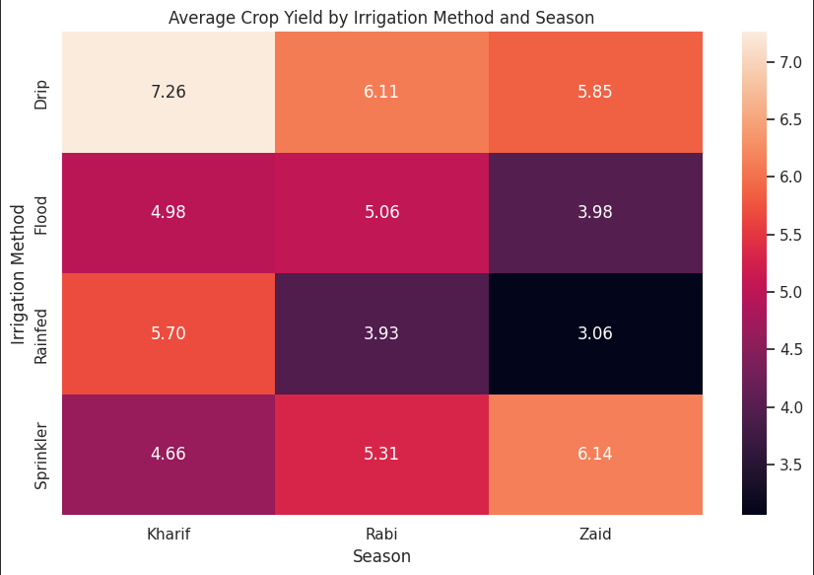
RESULTS
Irrigation method affects crop yield differently across seasons. Drip irrigation recorded the highest yield in Kharif (7.26), while sprinkler irrigation performed best in Zaid (6.14).

Slide 10
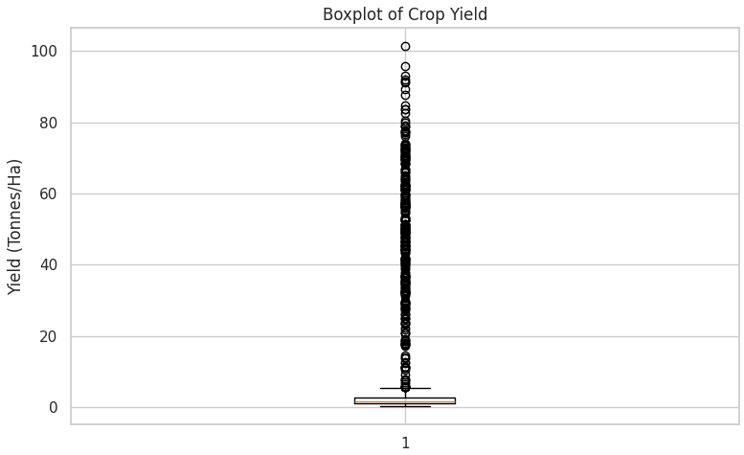
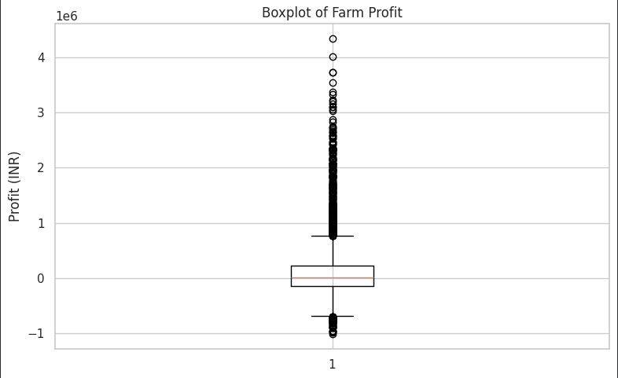
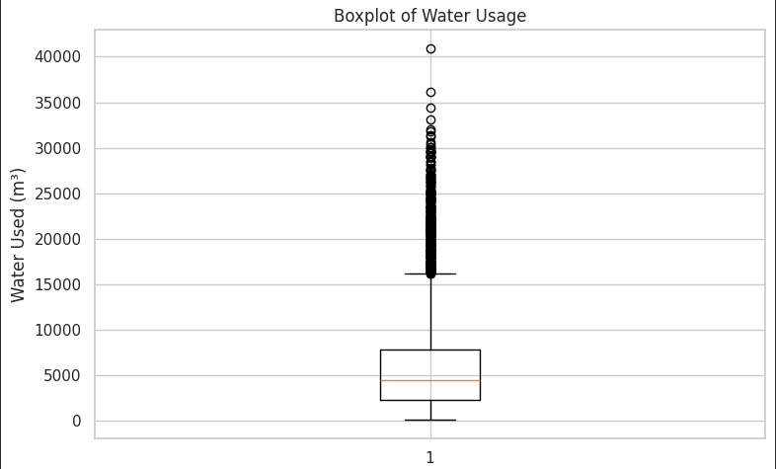
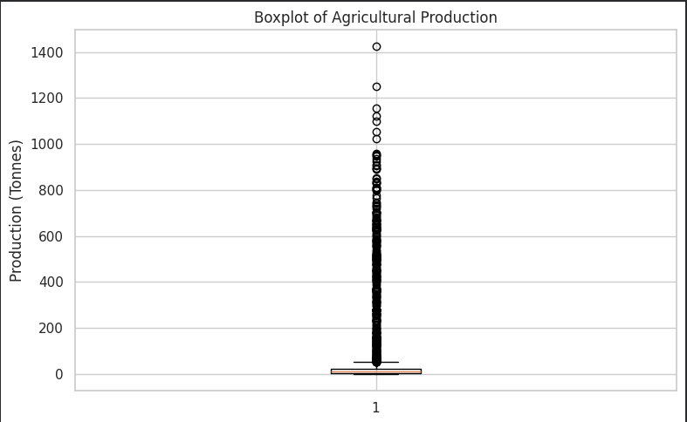
RESULTS
The boxplots show several extreme observations in crop yield, profit, water usage, and production. These variations indicate that agricultural performance can differ substantially between farms.

Slide 11
Future scope
Predictive Modelling – Predict future crop yield and agricultural performance for different seasons.
Weather-Based Prediction – Use weather conditions such as rainfall and temperature to improve seasonal predictions.
Resource Optimization – Recommend efficient irrigation, fertilizer, and water usage.
Crop Recommendation – Suggest suitable crops based on seasonal and regional conditions.
Larger Datasets – Include more regions, seasons, crops, and historical data for more reliable analysis.
Real-Time Monitoring – Integrate IoT or real-time environmental data for continuous agricultural monitoring.
Interactive Dashboard – Develop a dashboard to help farmers and planners easily monitor seasonal performance.

Slide 12
GitHub Link
https://github.com/kalvameghana2006-tech/Seasonal-Agriculture-Performance

Slide 13
VOIS Course completion certificate - Course name- Data Visualization

Slide 14
Thank you
.
.

